Slide 1
AMAZON
Sales Data Analysis
Ankur Bhatia

Slide 2
Purpose Of the Analysis
The primary purpose of this analysis is to extract actionable insights from the sales data to support informed decision-making and strategic planning.
Specifically, we aim to:
Identify trends and patterns in sales performance.
Understand customer behavior and preferences.
Optimize marketing strategies, product offerings, and customer engagement initiatives.
Improve operational efficiency and resource allocation.

Slide 3
Agenda For The Presentation
The agenda outlines the key topics that will be covered in the presentation, providing a roadmap for the audience. It will include :
Analysis of sales performance trends.
Examination of product category insights.
Exploration of customer segmentation findings.
Recommendations for marketing strategies and customer engagement initiatives.
Next steps and opportunities for further discussion.

Slide 4

DIVING DEEP
We will focus on general trends like :
Revenue
Orders
Products
Average Monthly Sales
Product Categories
Customer Segmentation

Slide 5
REVENUE
The total revenue from 2015-2020 : 107.2 Million
Average revenue per year : 17.87 Million
After few years of stagnant sales we were able to increase our revenue to 23.98 Million which was par average revenue.
The highest revenue (27.1Million) was generated by GREATER ACCRA region

Slide 6
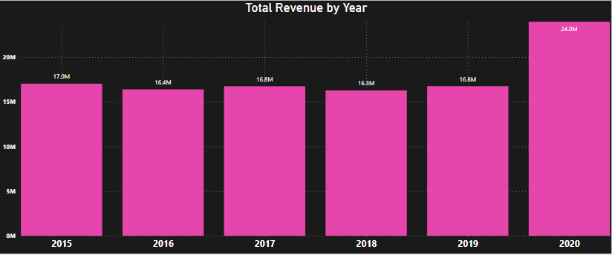

Slide 7
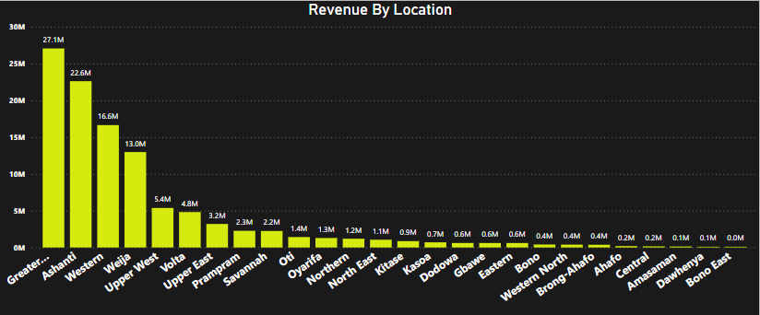

Slide 8
ORDERS
The same trend can be seen in total Orders placed.
The Orders stood at 112.99K from 2015-2020 and average orders per year were around 18.83K orders.
Last year our order count reached 25.18K.
The no. of customers also show same trend. We had stagnant customers for previous few years and last year we were able to break through consolidation to increase total customers. The no. of customers stood at 25.18K for the year 2020.

Slide 9
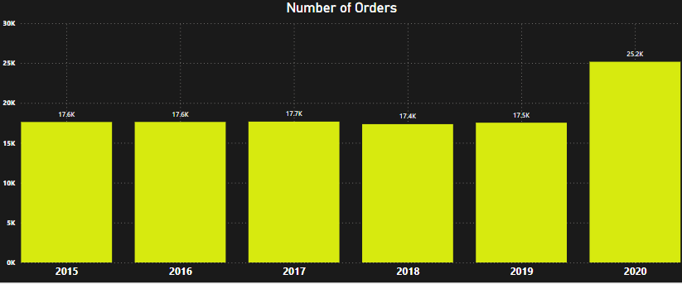

Slide 10
PRODUCTS
Best Selling Products :
Canon EOS 600D 18MP CMOS DSLR camera - Black
Canon EOS 60D 18MP CMOS DSLR camera Bundle - 18-55 mm lens – Black
Amazon Fire HD 8 kids Tablet 32GB HDD - 2GB Ram - 8” Blue
Worst Selling Products :
Hemani Ultra Slim Tea - 10 Bags
Yazole Leather Wrist Watch - Black
Clere Radiance Oil Control Toner - 100ml

Slide 11
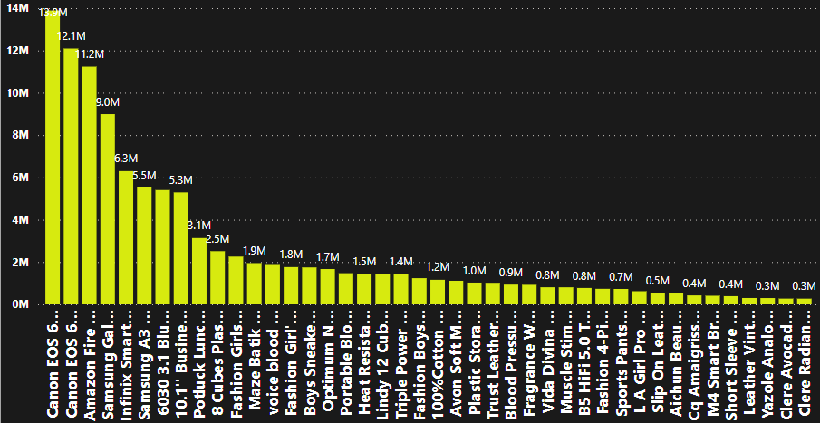

Slide 12
PRODUCTS
Returned Products :
The total no. of orders returned are 31K.
The reasons for returned are categorized in the chart based on percentage of overall returns.
We came to know that distribution is almost evenly spread between different reasons.
The reasons are defective item, missing item, not fitting expectation, wrong item, description mismatch.

Slide 13
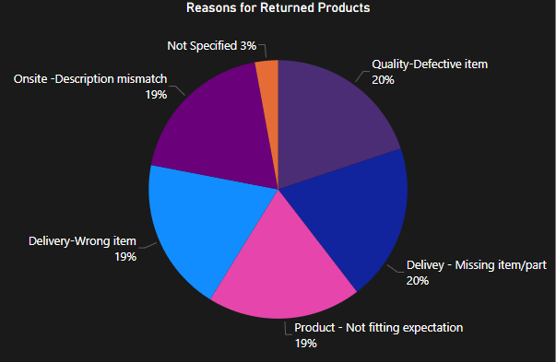

Slide 14
Average Monthly sales
Taking average of Monthly Sales, we can conclude that :
January has the Highest revenue
There is a significant drop in February
From March to May, Revenue is again up
Then again from June to December ,the revenue is low

Slide 15
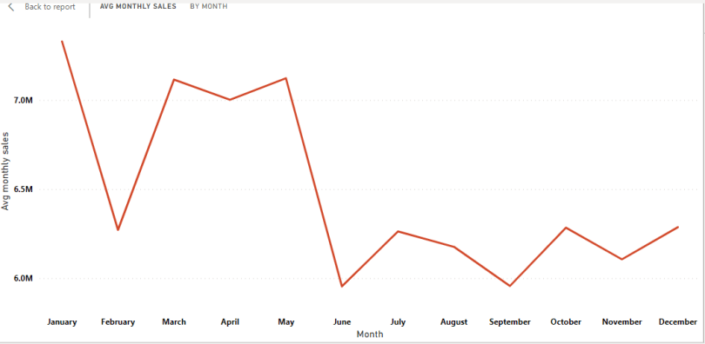

Slide 16
PRODUCT CATEGORIES
Following are 5 Product Categories available along with revenue :
Phone and Tablets – 33Million
Electronics – 33Million
Fashion – 12Million
Health and Beauty – 12Million
Home and Office – 12Million

Slide 17
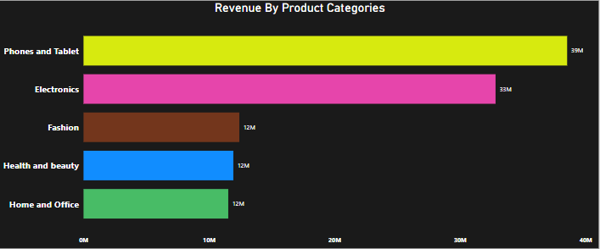

Slide 18
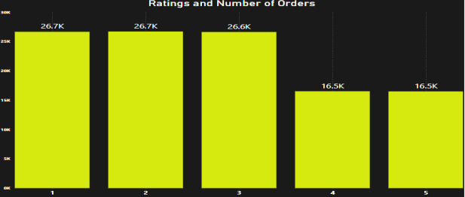
RATINGS
Maximum no. of orders had rating below 4. Total of 33k orders have rating 4 and 5 out of 112.99K orders.

Slide 19
RATINGS
After comparing revenue with different ratings, we can say that customers have very average ratings for products.
Maximum Product sales are in rating 1-3 meaning, we have been not able to deliver quality products or services to our customers.
Factors like Product quality, Waiting time, Wrong products delivered can be the reason for lower ratings.

Slide 20
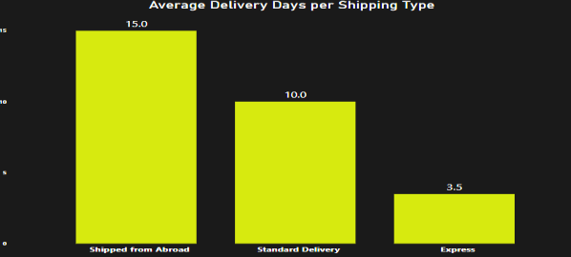
SHIPMENTS
There are total 3 types of shipment methods Express, Standard and Shipped from Abroad.

Slide 21
SHIPPING FEE
The chart shows shipping fee for different product categories.
Maximum shipping fees is for ‘Health and Beauty’ and ‘Fashion‘.
The reason for this is that categories like ‘Health and Beauty’ and ‘Fashion’ have less order values than the categories like ‘Electronics’ and ‘Phones and Tablet’ and so shipping fee increases for such categories.

Slide 22
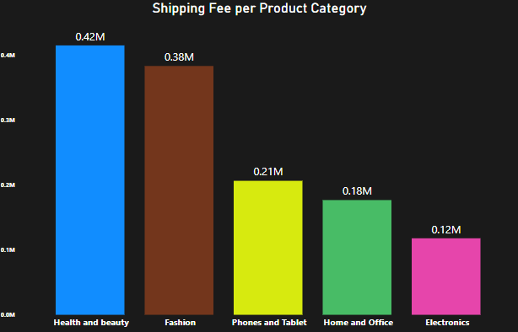

Slide 23
CONCLUSIONS
Waiting time is much higher than expected.
Average days for delivery is around 9.41 days. We need to take quick and on point decisions to solve this issue.
More warehouses and stores at key locations should be opened to increase connectivity and decrease no. of delivery days.

Slide 24
CONCLUSIONS
We can implement new marketing models to join more sellers near locations where the sellers are less and orders have to travel from far to get delivered, this will further increase our connectivity.
We will need to make sure all this sellers are authorized sellers and provide quality products or else it will further degrade our ratings

Slide 25
CONCLUSIONS
Product Ratings need to improve in order for us to perform well in future.
Improving product ratings revolve around two parameters. First is Product quality which is controlled by sellers and second is Service quality which amazon provides.
First, in order to give high quality products, we need to inspire sellers. We can do this by incentivising sellers whose products get higher ratings than other sellers.

Slide 26
CONCLUSIONS
Second, in order to provide better services, we can optimise our delivery network
We also need to reduce returned products, we can improve our apps to provide better size guides, better product descriptions and optimising our network to reduce missing or wrong item deliveries.

Slide 27
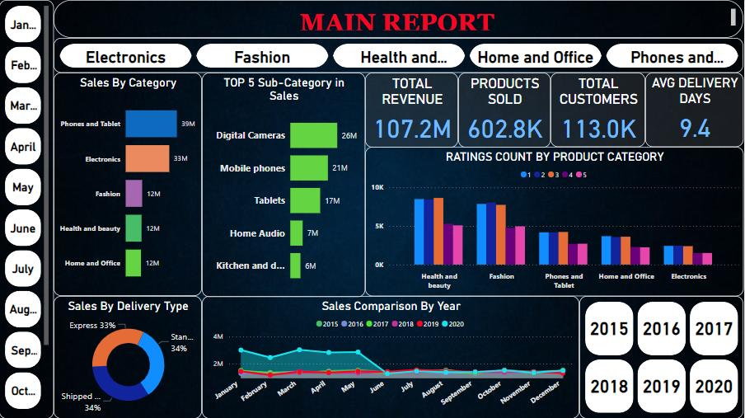

Slide 28
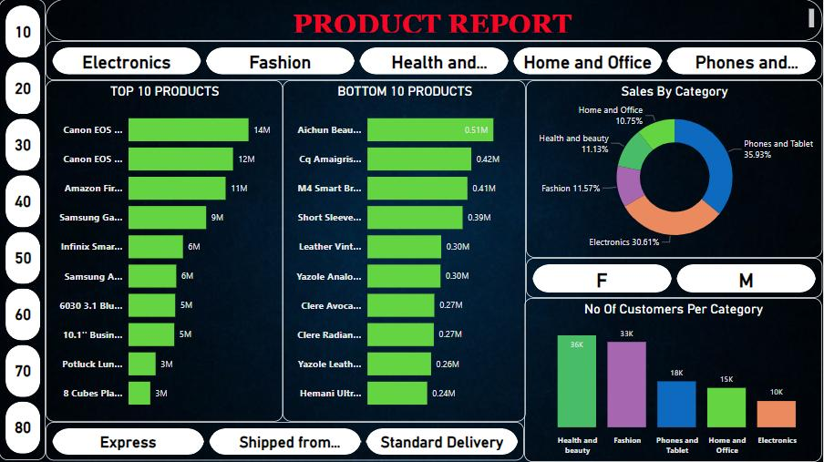

Slide 29
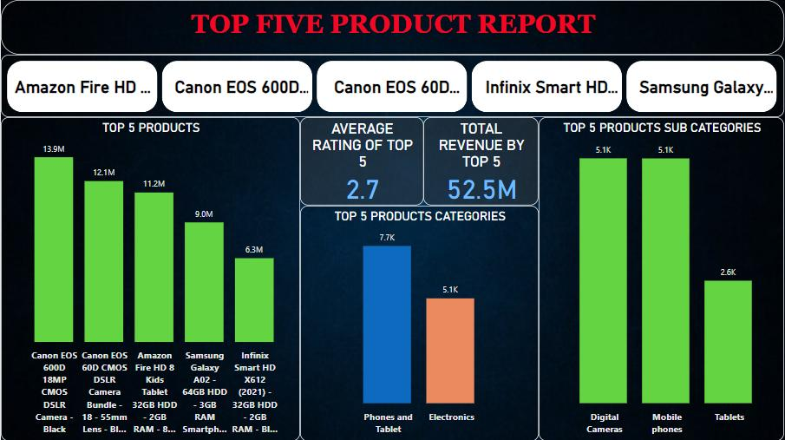

Slide 30
Thank you
Wasil Khan
8770720502
khanwasil39@gmail.com

